Slide 1
Graphs
CSC2253/CSC2251
Data Structure & Algorithms

Slide 2
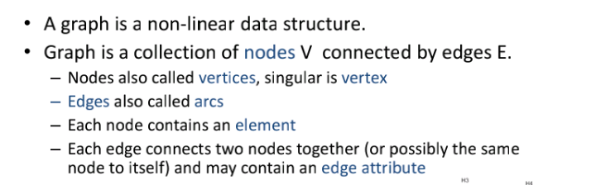
Introduction

Slide 3
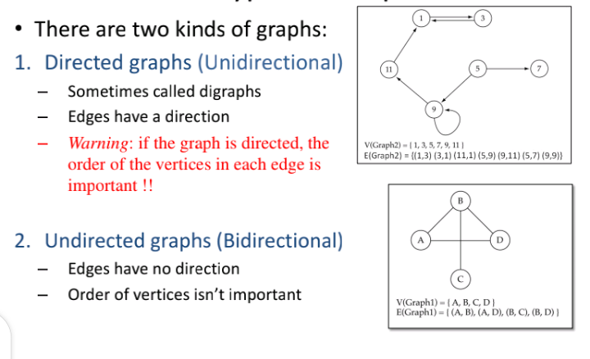
Types of Graphs

Slide 4
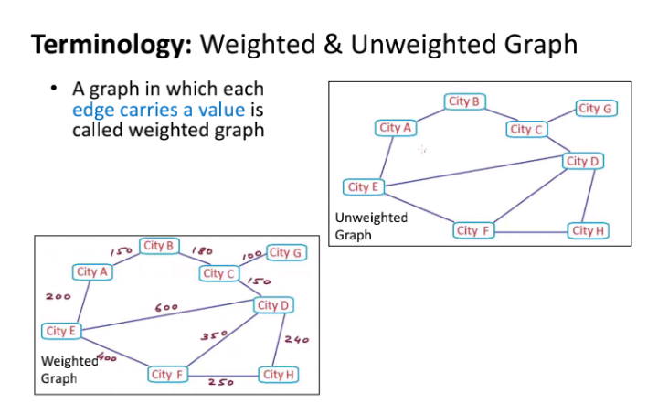
Terminology

Slide 5
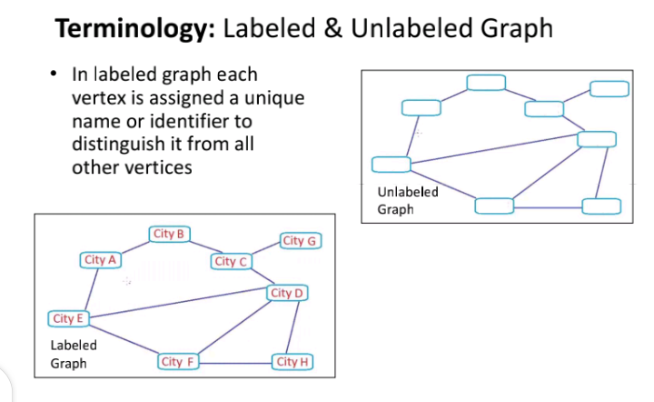
Terminology Cont…

Slide 6
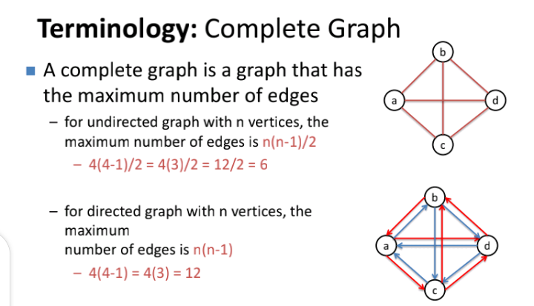
Terminology Cont…

Slide 7
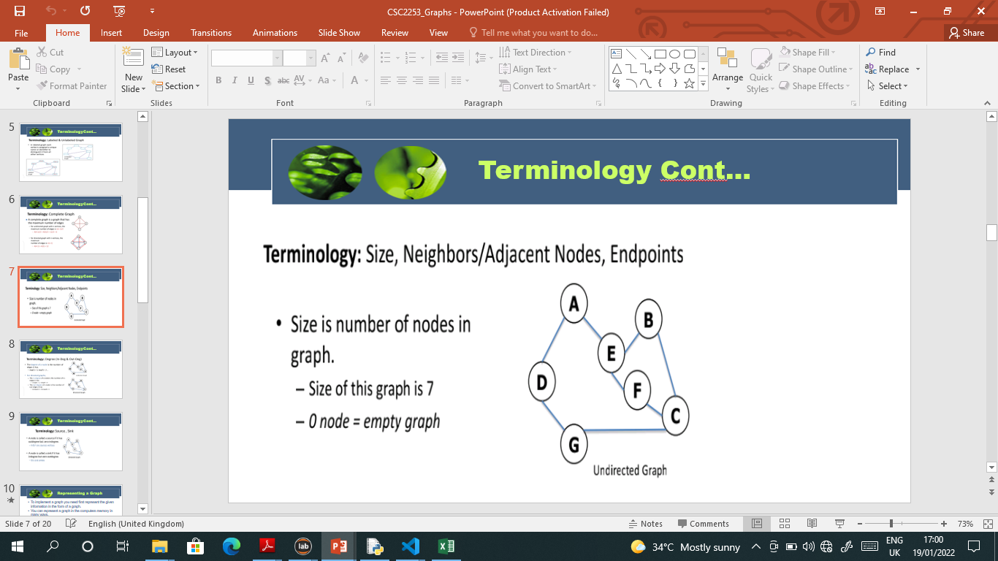
Terminology Cont…

Slide 8
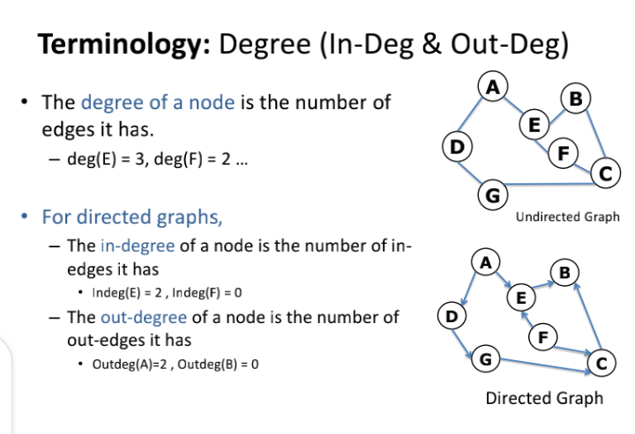
Terminology Cont…

Slide 9
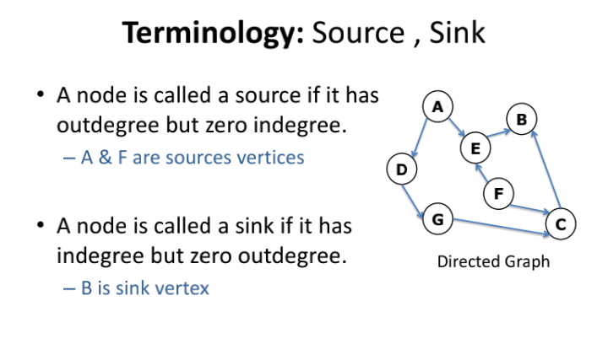
Terminology Cont…

Slide 10
Representing a Graph
To implement a graph you need first represent the given information in the form of a graph.
You can represent a graph in the computers memory in many ways.
The two most commonly used ways of representing a graph are:
Adjacency Matrix
Adjacency list

Slide 11
Adjacency Matrix
An adjacency matrix uses a two dimensional array to represent a graph.
If there are n vertices in a graph, you need a two dimensional array of size
n * n to represent the graph.
Let A be the adjacency matrix for a graph. Information pertaining to the edges is stored in the adjacency matrix in the following manner:
A[i, j] = 1, if there is an edge from vertex with index i to vertex with index j
A[i, j] = 0, if there is no edge from vertex with index i to vertex with index j

Slide 12
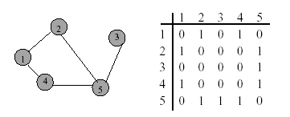
Example

Slide 13
Adjacency Matrix Properties
Diagonal entries are zero.

Slide 14
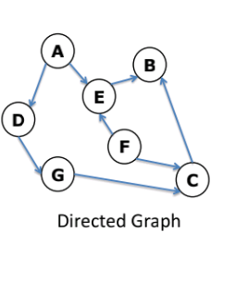
Example
What is the adjacency matrix of the graph below?

Slide 15
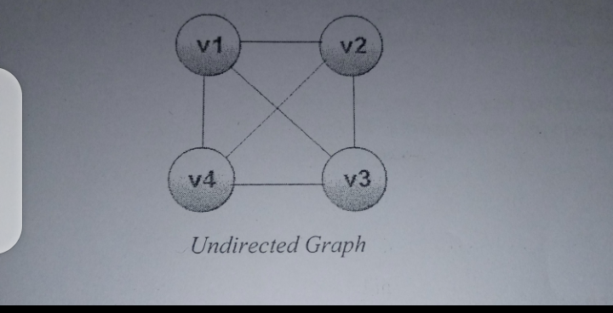
Adjacency List
An adjacency list uses a linked representation for a graph.
Consider the following undirected graph

Slide 16
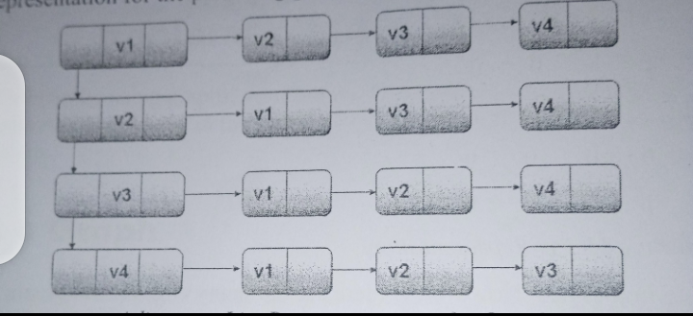
Example Cont…

Slide 17
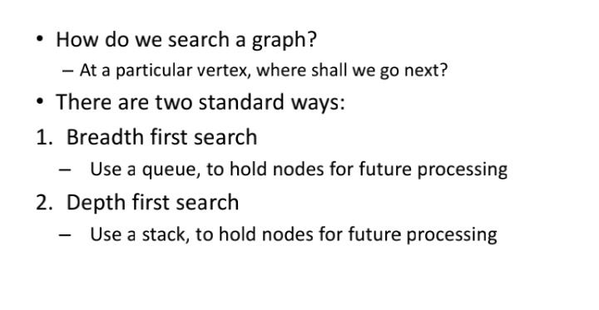
Traversing a Graph

Slide 18
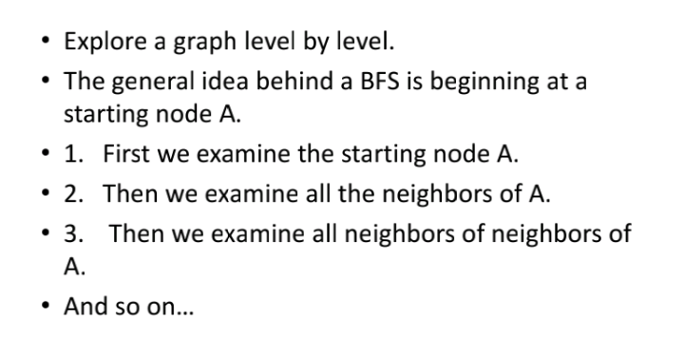
Breadth First Search

Slide 19
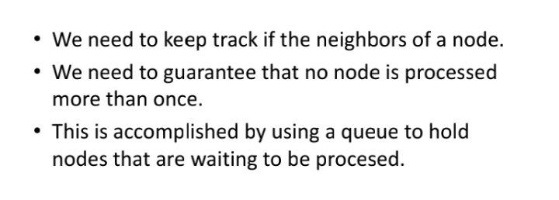
Breadth First Search Cont…

Slide 20
BFS Cont…
Algorithm
Visit the starting vertex, and insert it into the queue.
Repeat step 3 until the queue becomes empty.
Delete the front vertex from the queue, visit all its unvisited adjacent vertices, and insert them into the queue.

Slide 21
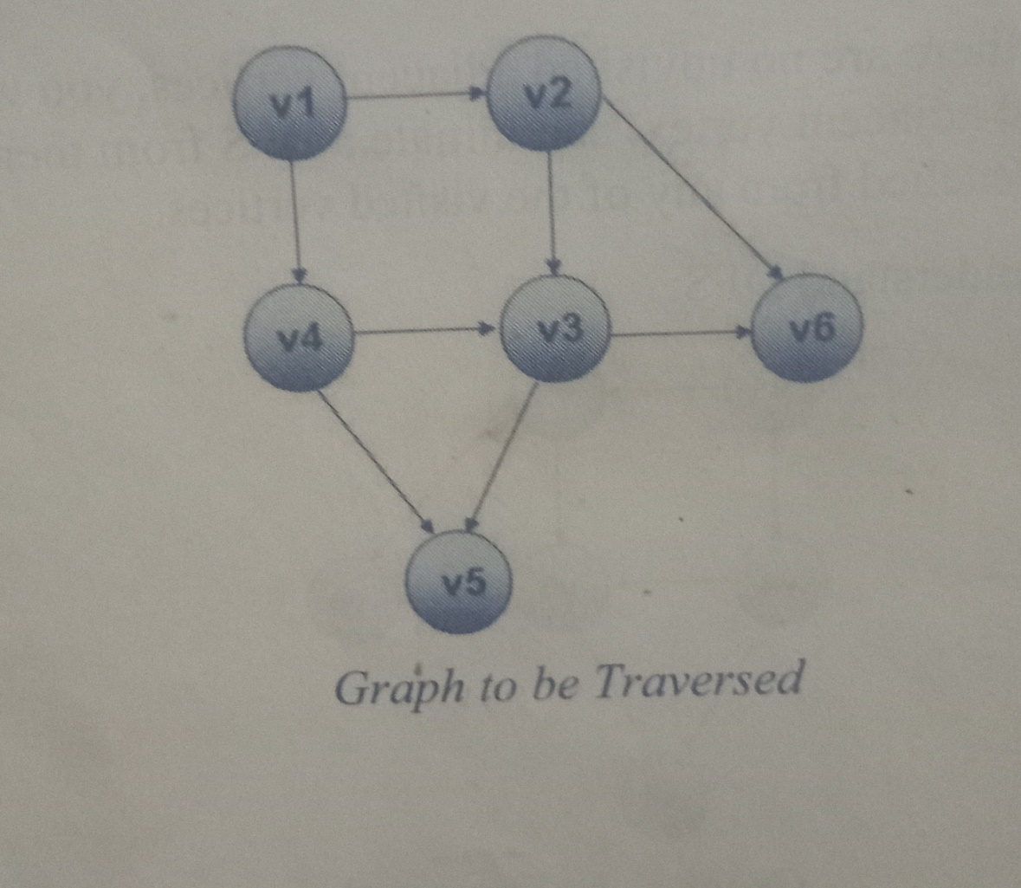
Example

Slide 22
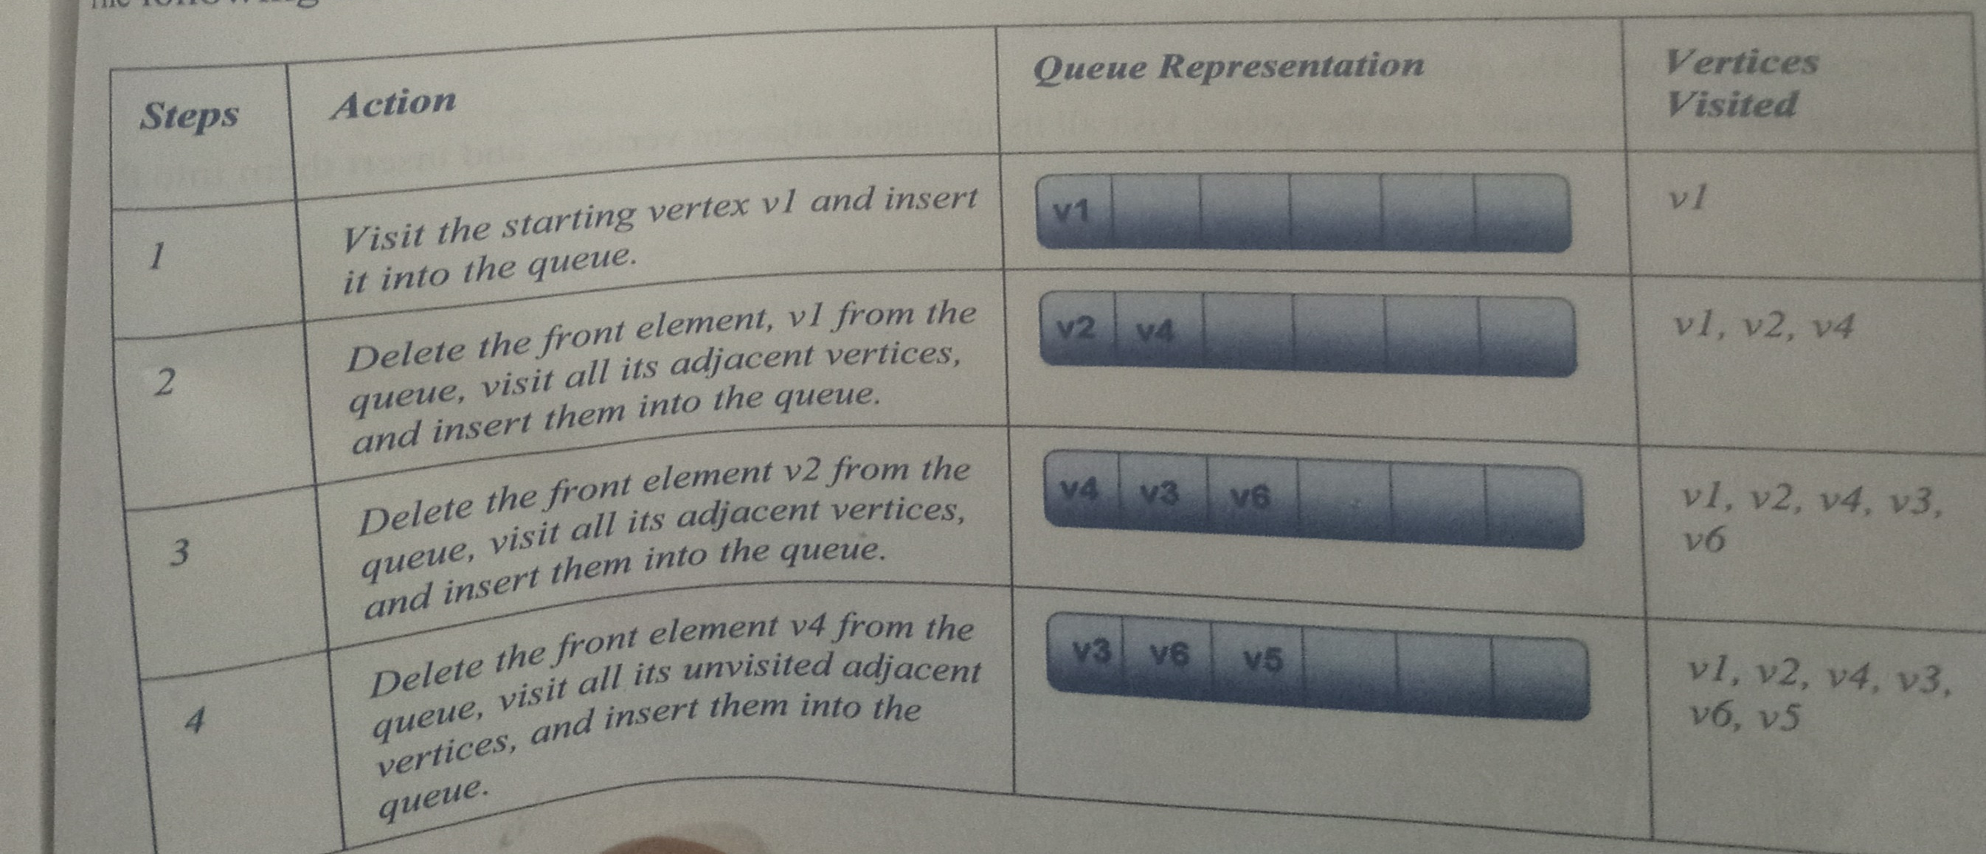
Example

Slide 23
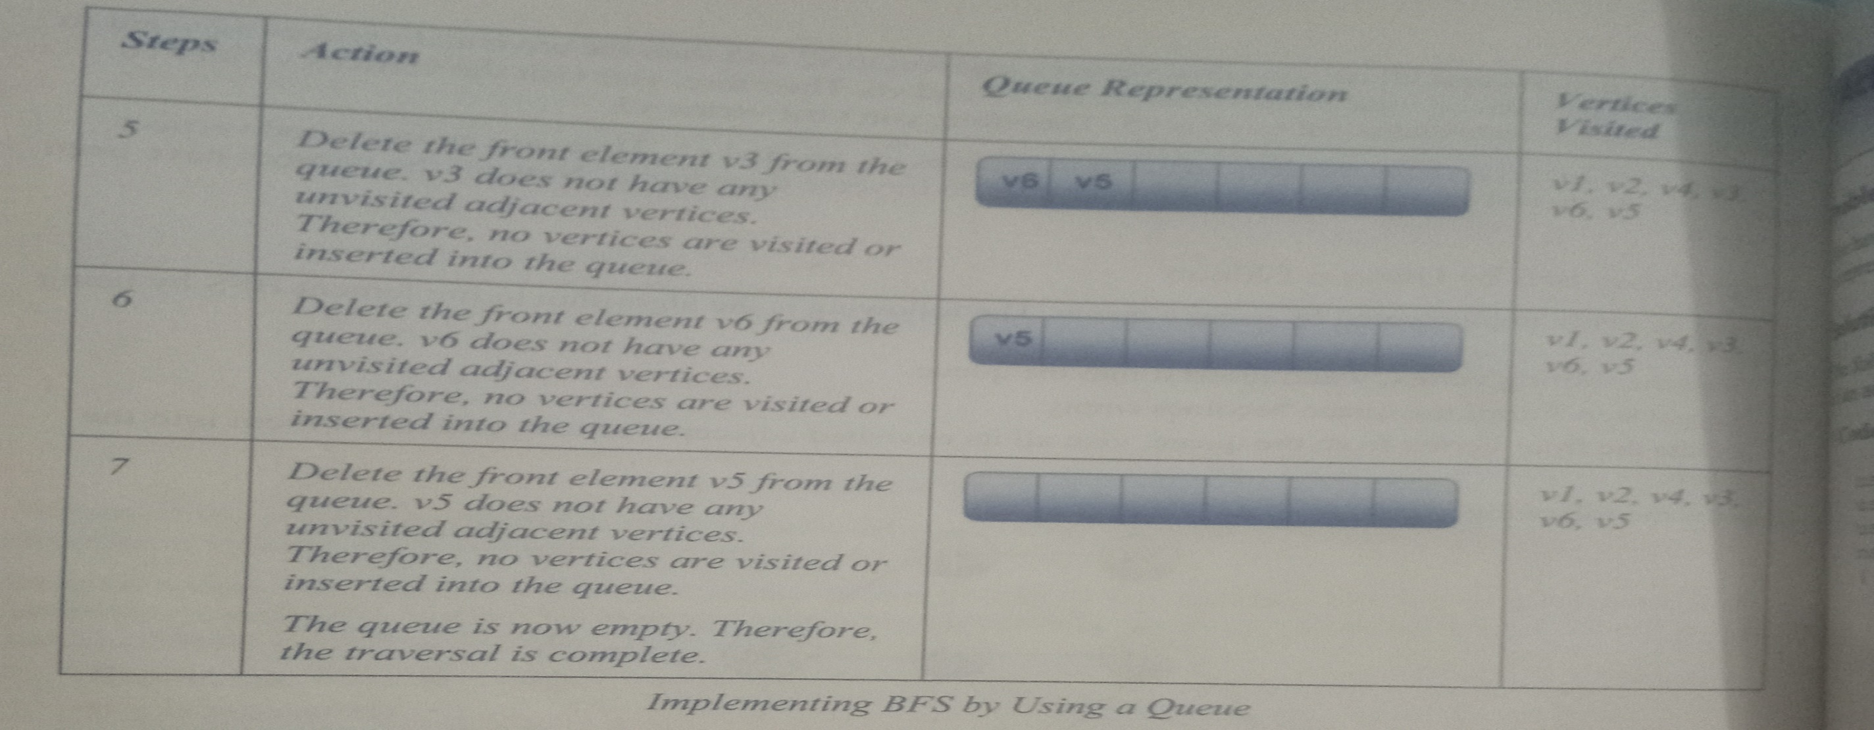
Example Cont…

Slide 24
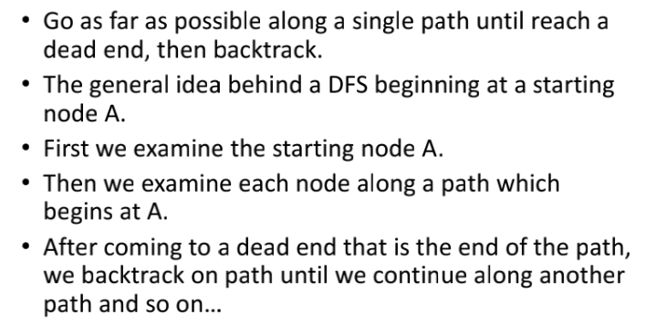
Depth First Search

Slide 25
DFS Cont…
Algorithm
Push the starting vertex into the stack.
Repeat until the stack becomes empty:
Pop a vertex from the stack.
Visit the popped vertex.
Push all the unvisited vertices adjacent to the popped vertex into the stack.

Slide 26
Example

Slide 27
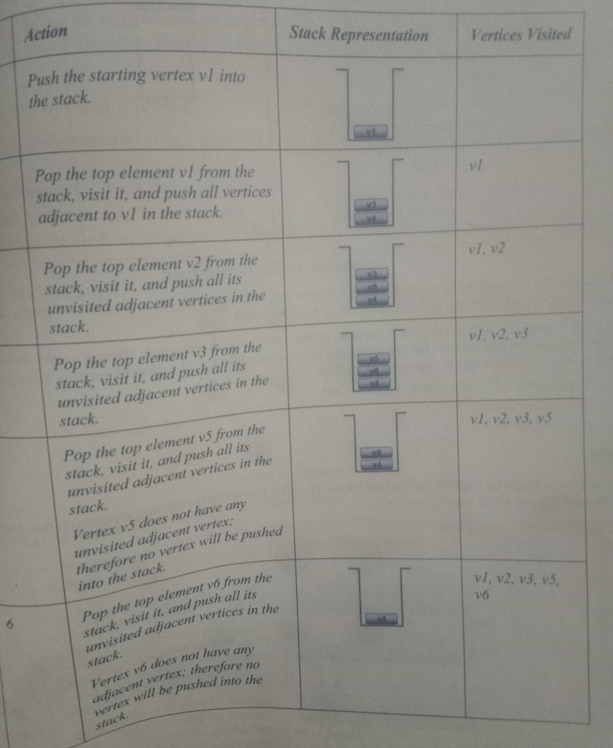
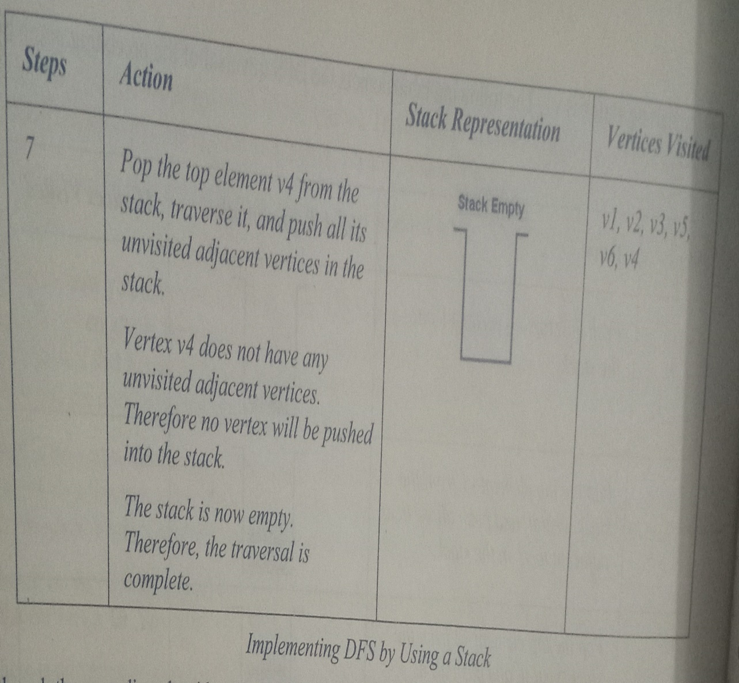
Example Cont…

